Slide 1
Local Government Data in Open Book New York
Sarah Lauser · Rockefeller Institute · 2023-03-24

Slide 2
Topics
What’s available in Open Book
NYS geographic hierarchy
Data dictionary / data decoding
Upcoming changes to LG data

Slide 3

https://openbookny.com/
https://www.osc.state.ny.us/open-book-new-york

Slide 4
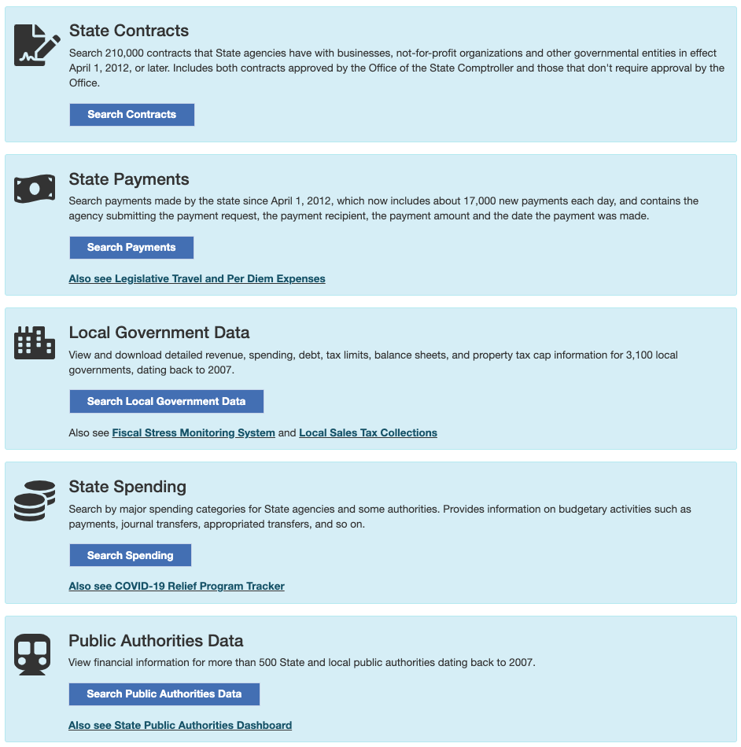

Slide 5
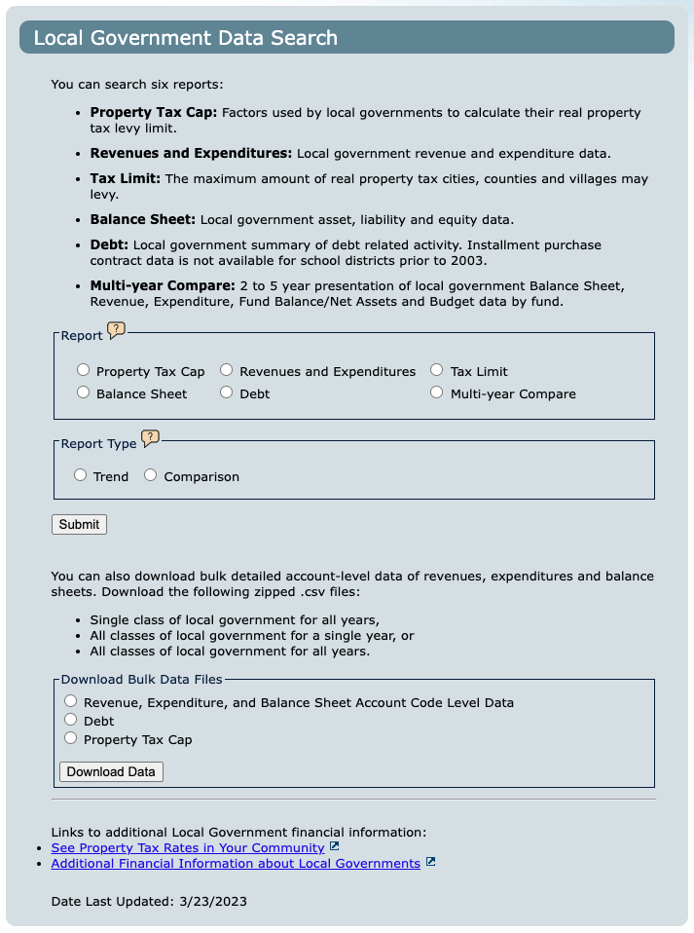


Built-in reporting options
Trend
up to 6 years
Comparison
up to 4 entities
Bulk data downloads
Update date

Slide 6
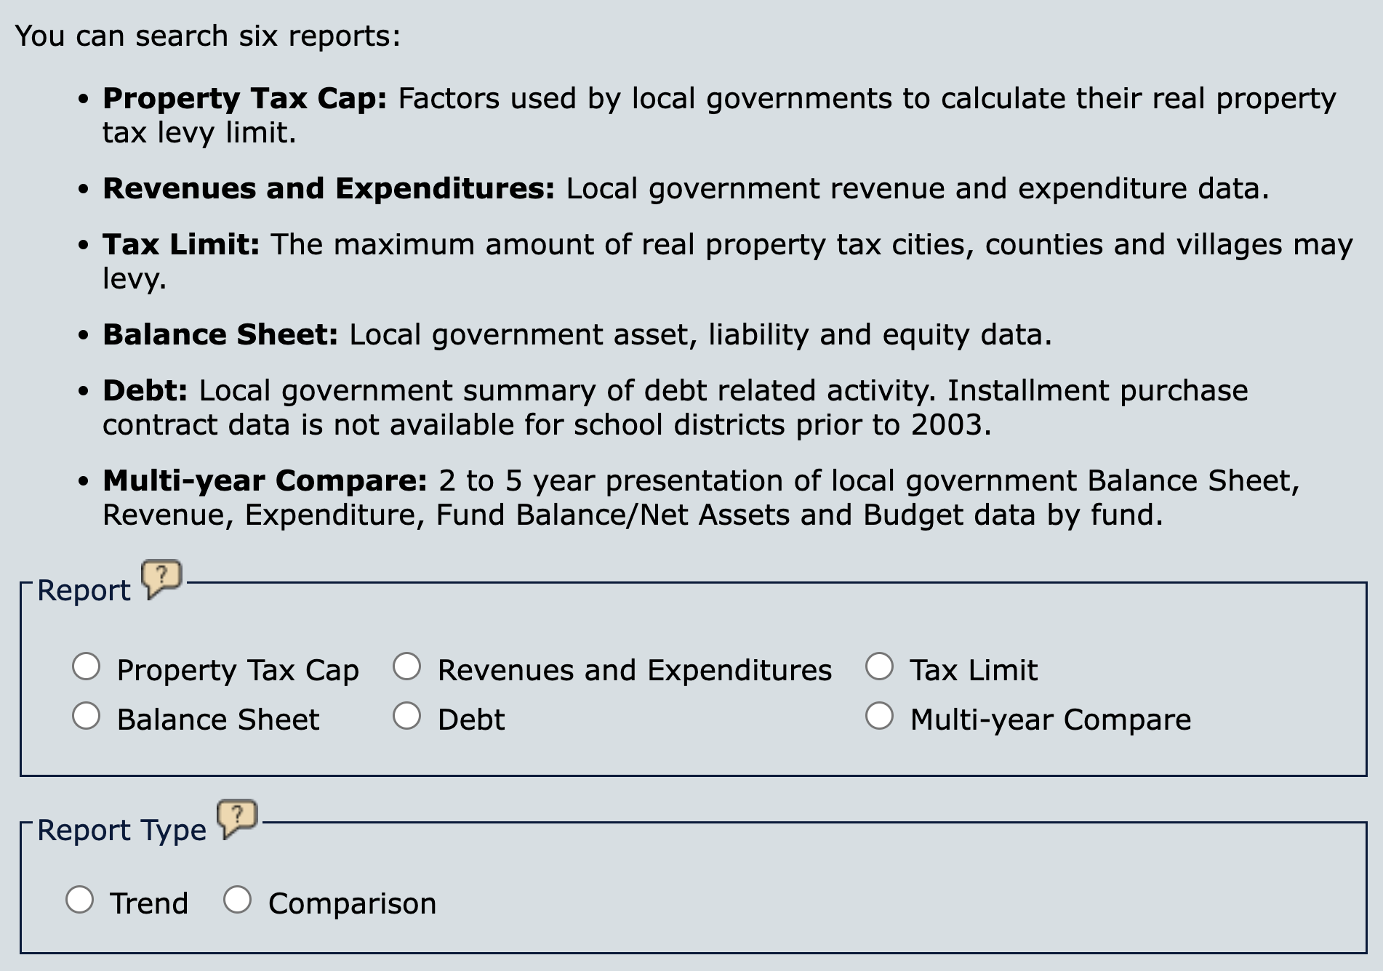
Trend or Comparison
Comparison only

Slide 7
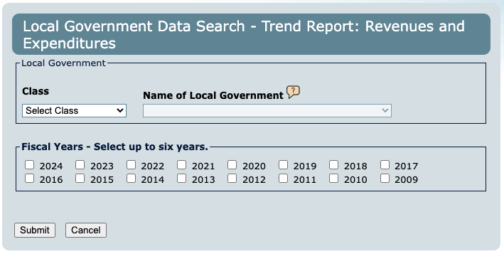
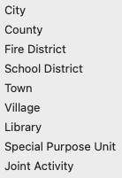
Revenues and Expenditures Trend
Classes

Slide 8
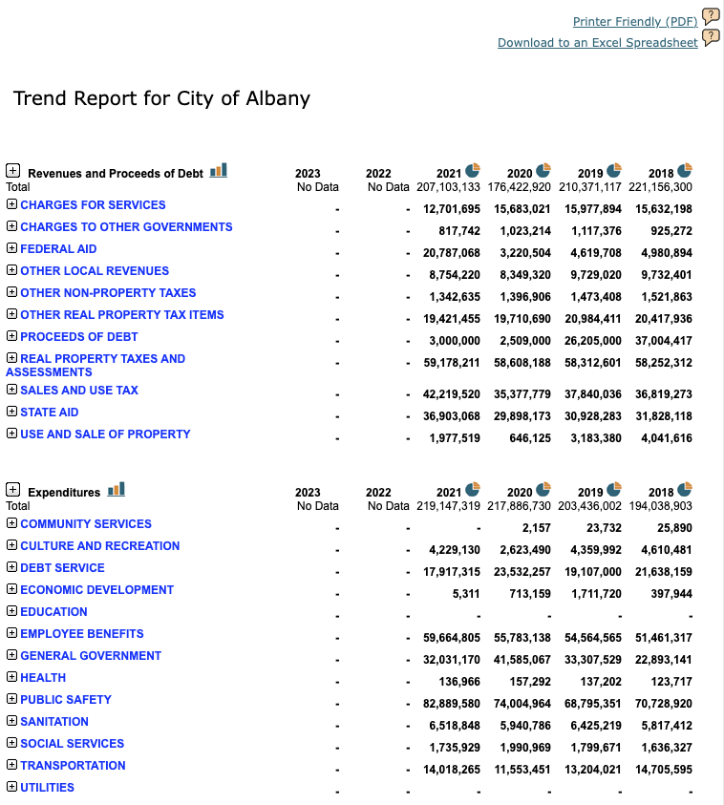
Retrieved 2023-03-23

Slide 9

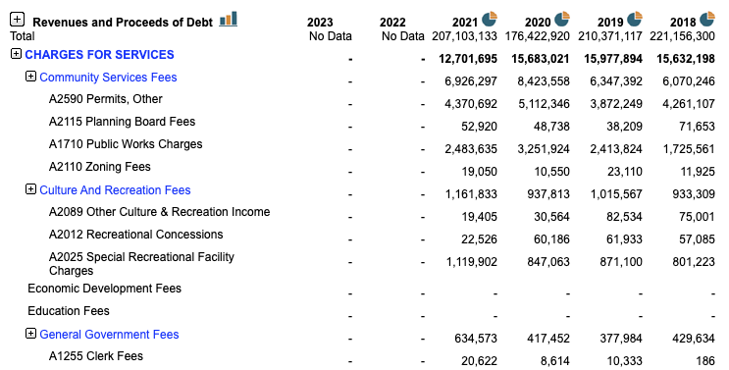
Retrieved 2023-03-23
Expand/Collapse by clicking either or blue heading
Level 1 Category
Level 2 Category
Account Code & Narrative

Slide 10
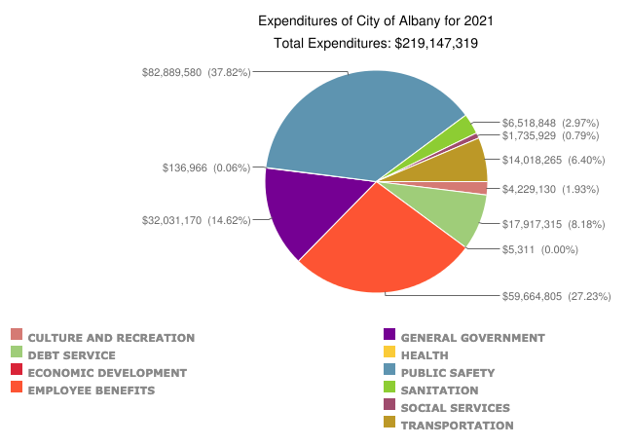
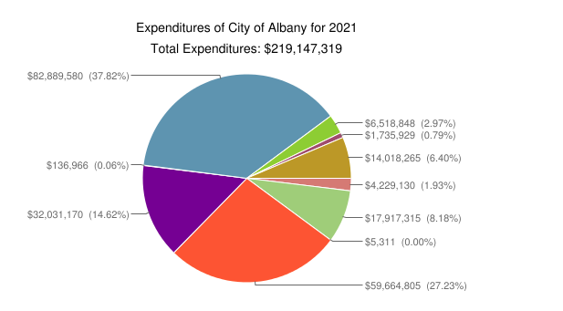
Retrieved 2023-03-23
Expand/Collapse by clicking either or blue heading
Level 1 Category
Level 2 Category
Account Code & Narrative

Slide 11
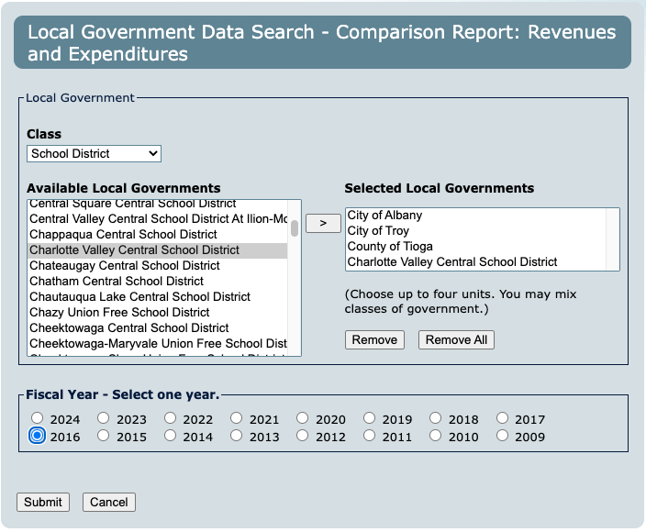
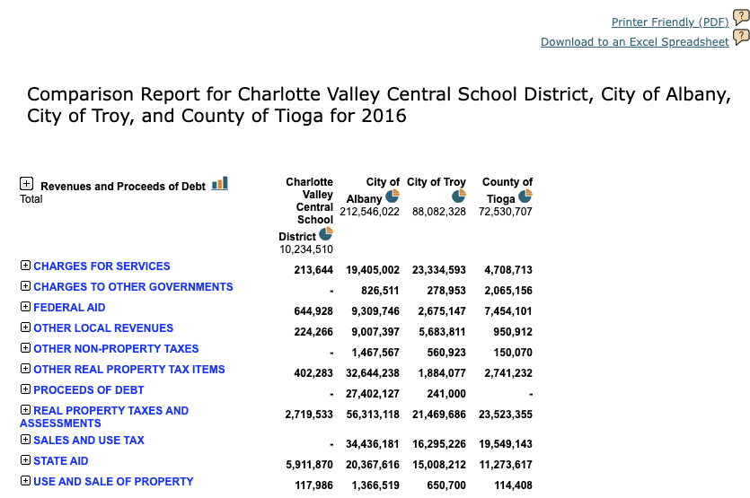
Revenues and Expenditures Comparison

Slide 12
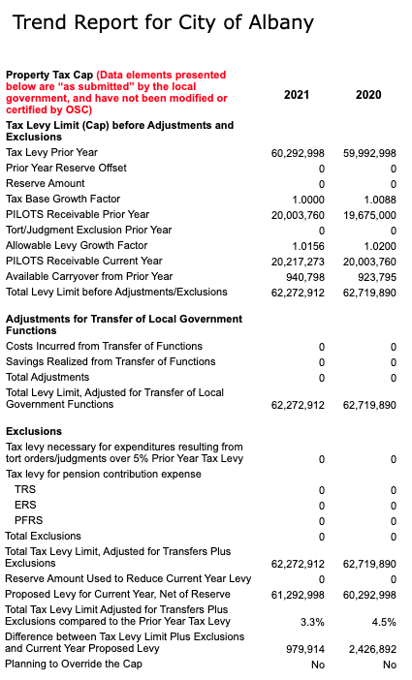
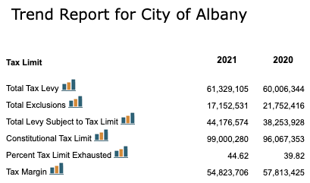
Tax Cap
vs.
Tax Limit
Trend Report for City of Albany, 2020-2021

Slide 13
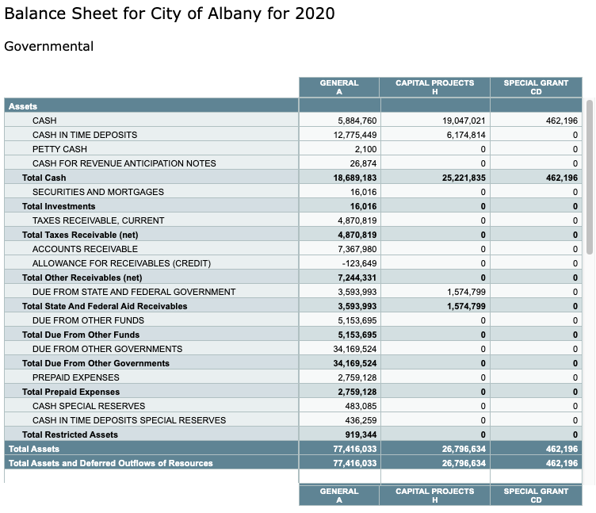
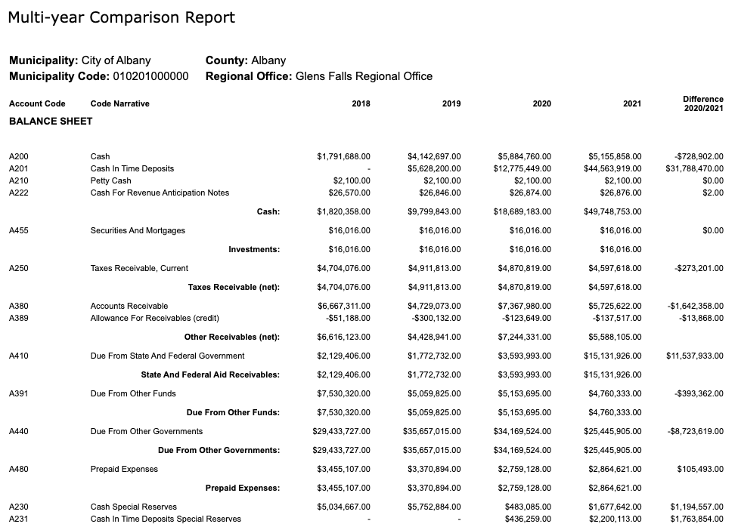
Balance Sheet
vs.
Multi-year Compare

Slide 14
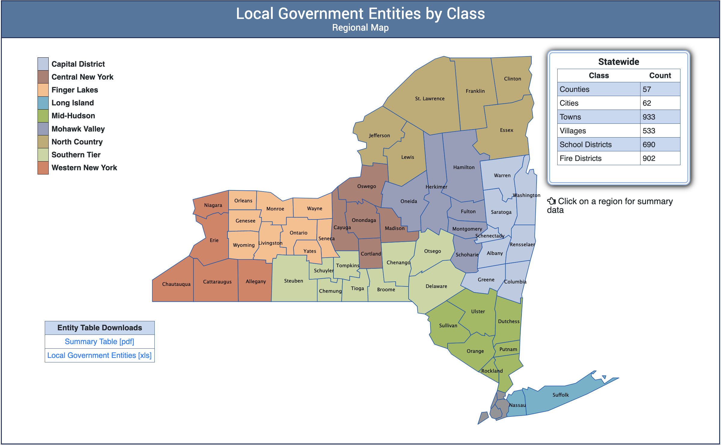
NYS Geographic Hierarchy
* + 5 NYC = 62
General Purpose Counties, Cities, Towns, Villages
Special Purpose School Districts, Fire Districts
Other Library, Special Purpose Unit, Joint Activity

Slide 15

Standard* Hierarchy of New York Geographic Entities
State
County
City/Town*
Village*

Slide 16
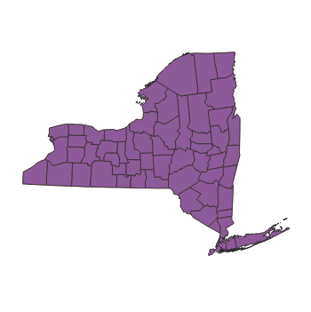
Standard* Hierarchy of New York Geographic Entities
State
County
City/Town*
Village*

Slide 17
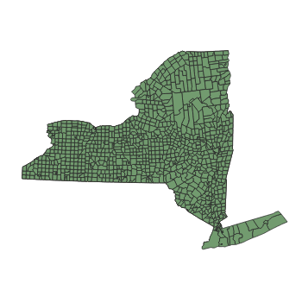
Standard* Hierarchy of New York Geographic Entities
State
County
City/Town*
Village*

Slide 18
Standard* Hierarchy of New York Geographic Entities
State
County
City/Town*
Village*
* Cities that cross county lines:
SWIS Code | Name | % by area
320500 | City of Geneva | Ontario 72.27% | Seneca 27.73%
650000 | City of New York | Queens 38.17% | (Staten Island) Richmond 21.79% | (Brooklyn) Kings 20.66% | Bronx 12.22% | (Manhattan) New York 7.17%

Slide 19
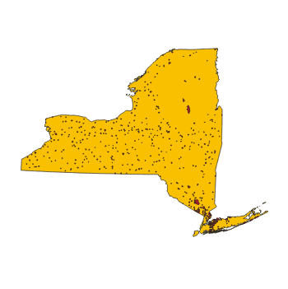
Standard* Hierarchy of New York Geographic Entities
State
County
City/Town*
Village**

Slide 20
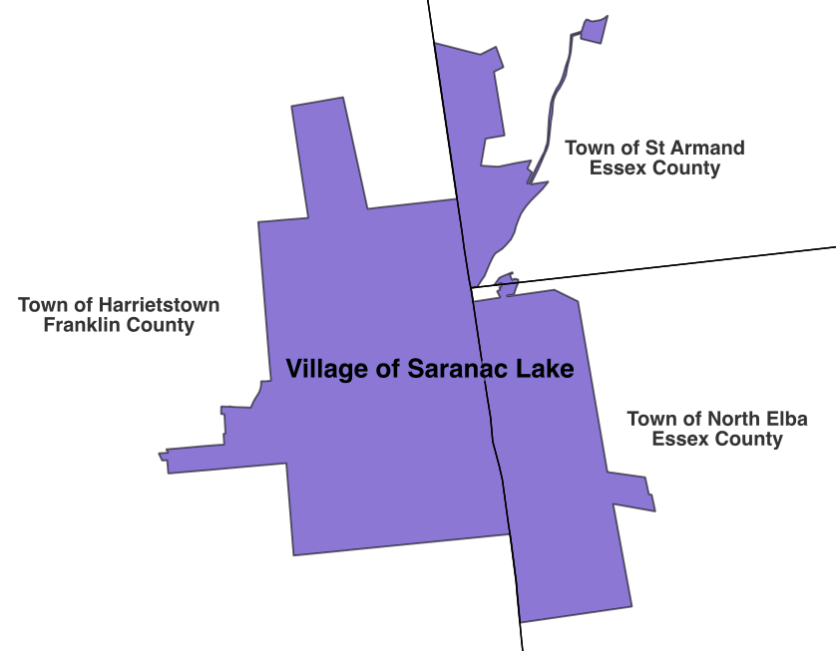
** Villages that cross town/county lines (SWIS codes in parentheses)
crosses 2 towns in 1 county | Albion (342001), Baldwinsville (313601), Ballston Spa (412001), Black River (224001), Briarcliff Manor (553405), Broadalbin (172201), Brockport (265201), Cambridge (532201), Cato (052403), Chatham (102601), Chester (332201), Clifton Springs (323605), Cooperstown (363801), Corfu (184201), Croghan (232001), Dannemora (093401), Dansville (243801), Depew (143003), East Hills (282203), Elmira Heights (073001), Floral Park (282007), Florida (335401), Glen Park (222605), Greenwich (532601), Harriman (334003), Homer (112201), Hunter (193601), Ilion (212801), Lyons Falls (233803), Mamaroneck (553203), Maybrook (333401), Medina (343401), Middleport (292201), Middleville (212401), Mineola (282039), Montour Falls (442403), New Hyde Park (282041), New York Mills (304803), North Syracuse (312201), Norwood (406201), Nyack (392005), Odessa (442001), Old Westbury (282231), Ovid (452801), Perry (562603), Poland (213805), Pomona (392205), Port Leyden (233401), Remsen (305201), Richburg (023803), Roslyn Harbor (282245), Sag Harbor (472403), Sinclairville (062601), Spring Valley (392003), Stamford (123801), Valley Falls (383601), Wappingers Falls (134601), Waterville (304601), Watkins Glen (442401), Williamsville (142201), Wolcott (542201)
crosses 3 towns in 1 county | Fort Plain (272205), Hamilton (253203), Massena (405201), Penn Yan (572201), Waterloo (452201)
crosses 2 towns in 2 counties | Almond (022601), Attica (182203), Deposit (034201), Dolgeville (173401), Earlville (085601), Gowanda (047201), Rushville (323201)
crosses 3 towns in 2 counties | Saranac Lake (154003)

Slide 21
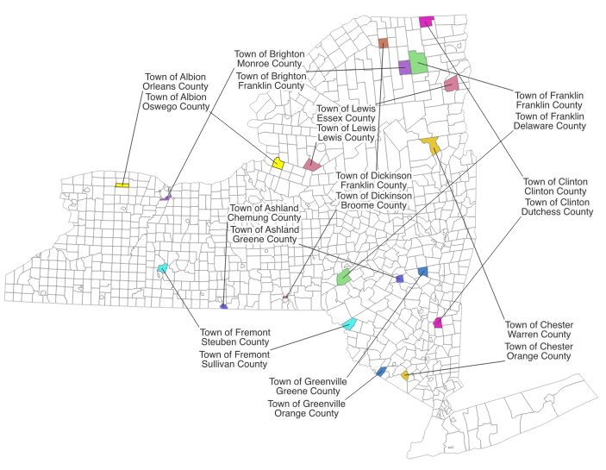
Pairs of towns with the same name
Town | County 1 | County 2
Albion | Orleans | Oswego
Ashland | Chemung | Greene
Brighton | Franklin | Monroe
Chester | Orange | Warren
Clinton | Clinton | Dutchess
Dickinson | Broome | Franklin
Franklin | Delaware | Franklin
Fremont | Steuben | Sullivan
Greenville | Greene | Orange
Lewis | Essex | Lewis

Slide 22
Villages not in their matching towns
Name | Village |  |  | Town
Name | SWIS Code | Town List | County | County | SWIS Code
Albion | 342001 | Albion (Orleans County), Gaines | Orleans | Oswego | 352000
Aurora | 053401 | Ledyard | Cayuga | Erie | 142400
Barker | 293801 | Somerset | Niagara | Broome | 032000
Chester | 332201 | Chester (Orange County), Goshen | Orange | Warren | 522400
Clinton | 304001 | Kirkland | Oneida | Clinton | 093200
 |  |  |  | Dutchess | 132400
Dansville | 243801 | North Dansville, Sparta | Livingston | Steuben | 464000
Dresden | 573601 | Torrey | Yates | Washington | 532400
Florida | 335401 | Goshen, Warwick | Orange | Montgomery | 272600
Franklin | 123201 | Franklin (Delaware County) | Delaware | Franklin | 164400
Greenport | 473801 | Southold | Suffolk | Columbia | 104000
Lawrence | 282023 | Hempstead | Nassau | St Lawrence | 404800
Mohawk | 212803 | German Flatts | Herkimer | Montgomery | 273200
Poland | 213805 | Newport, Russia | Herkimer | Chautauqua | 065600
Victory | 415003 | Saratoga | Saratoga | Cayuga | 056400
Waverly | 492001 | Barton | Tioga | Franklin | 165400

Slide 23
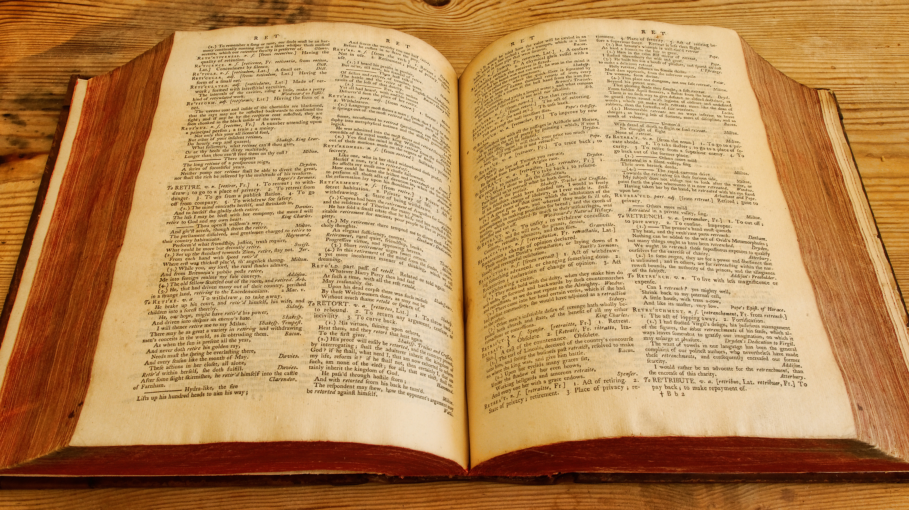
Data Dictionary
image by Alex Brown (CC BY 2.0)

Slide 24
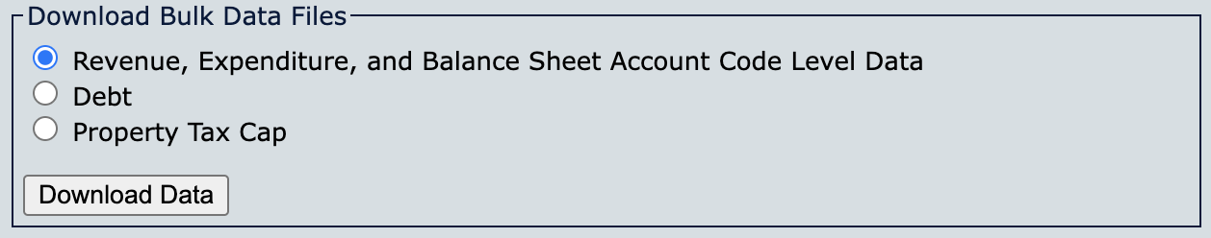
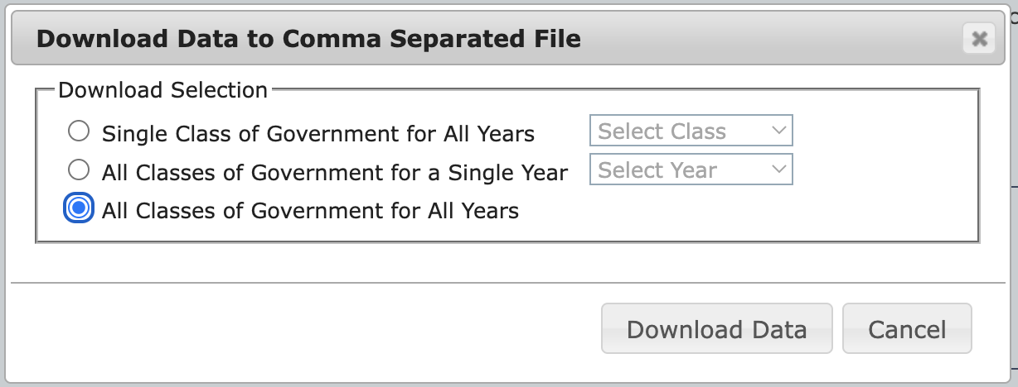
all_classes_years.zip ≅ 270 MB
unzipped ≅ 3.13 GB
one file per year (1995 – present) per class (County, City, Town, Village, School District, Fire District)

Slide 25

Column | Type | Notes | Sample Value
CALENDAR_YEAR | INTEGER | YYYY | 2021
MUNICIPAL_CODE | CHAR (12) | 12 digits, but may start with 0 * contains smart coding | 010201000000
ENTITY_NAME | CHAR | display name, not good for joining | City of Albany
CLASS_DESCRIPTION | CHAR | ENTITY_TYPE | City
COUNTY | CHAR | the county with the largest area % | Albany
FISCAL_YEAR_END | CHAR | MM/DD | 12/31
ACCOUNT_CODE | CHAR | 1-2 letters followed by 3-5 digits * contains smart coding | A51424
ACCOUNT_CODE_NARRATIVE | CHAR |  | Snow Removal, Contr Expend
FINANCIAL_STATEMENT | CHAR |  | STATEMENT OF EXPENDITURES AND OTHER USES
FINANCIAL_STATEMENT_SEGMENT | CHAR |  | EXPENDITURES
LEVEL_1_CATEGORY | CHAR |  | TRANSPORTATION
LEVEL_2_CATEGORY | CHAR |  | HIGHWAYS
OBJECT_OF_EXPENDITURE | CHAR | only present if FINANCIAL_STATEMENT = “STATEMENT OF EXPENDITURES AND OTHER USES” | Contractual
AMOUNT | NUMBER | dollar amount (may contain cents) | 1227218
SNAPSHOT_DATE | CHAR | date last updated as DD-MON-YY | 28-FEB-23
🔑
🔑
🔑
🔑

Slide 26
ACCOUNT_CODE smart coding
The first 1-2 letters represent the fund e.g., A = General
The number of digits represents the type of account
3 digits = general ledger
4 digits = revenue
5 digits = expenditure
The final digit of the expenditure code represents the object of the expenditure
The account numbers are further divided into categorical ranges
Example:
A51424 is an expense (5 digits) paid out of the general fund (A) for Transportation (range 5000x – 5999x) and represents contractual payment (ends in a 4).

Slide 27
MUNICIPAL_CODE smart coding
Digits 1-2 represent the county
Digits 3-4 represent the class of government
Class Code | Entity Count (2021) | Description
01 | 57 | County
02 | 55 | City
03 | 855 | Town
04 | 501 | Village
05 | 61 | School District - City Public School
06 | 276 | School District - Independent Superintendent
07 | 267 | School District - Central
08 | 3 | School District - Central High
09 | 75 | School District - Union Free
10 | 10 | School District - Common
11 | 741 | Fire District

Slide 28

Watch out for:
Similar entity names
Changing fiscal year-end dates
(can cause short or extended years)
Overlapping real property taxes
https://www.osc.state.ny.us/local-government/data/overlapping-real-property-tax-rates-and-levies-faqs

Slide 29

Upcoming changes
New AFR/AUD system expected Fall 2023
Same account codes
Expected conversion for all 2013+ data

Slide 30
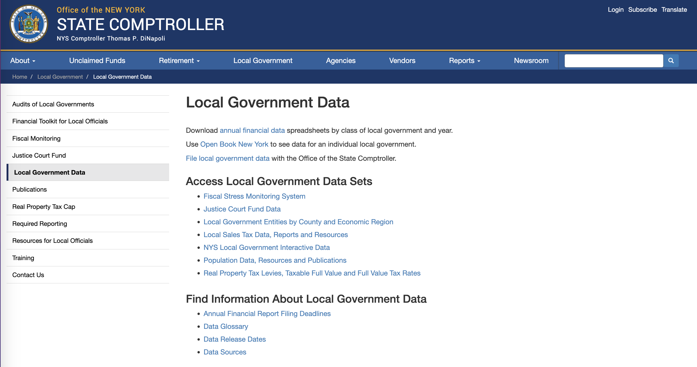
https://www.osc.state.ny.us/local-government/data

Slide 31
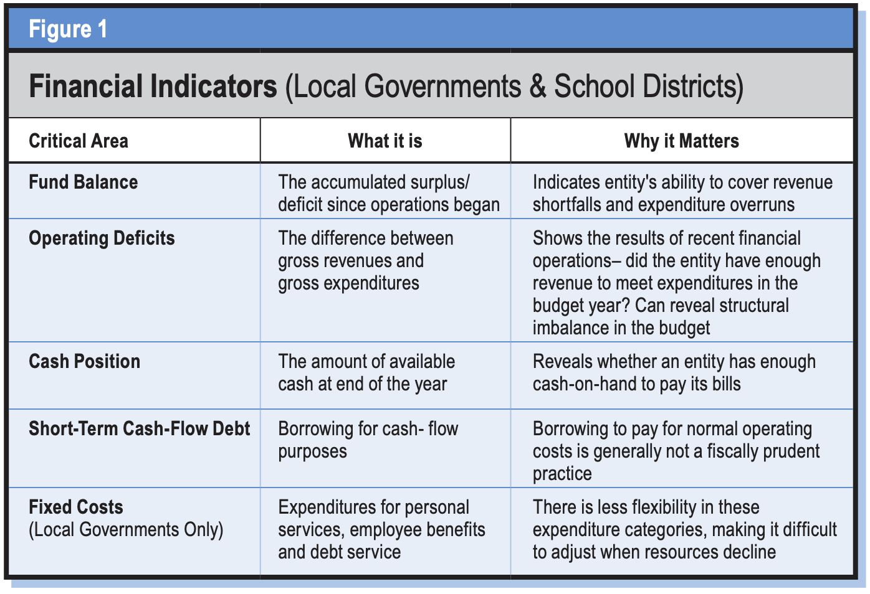
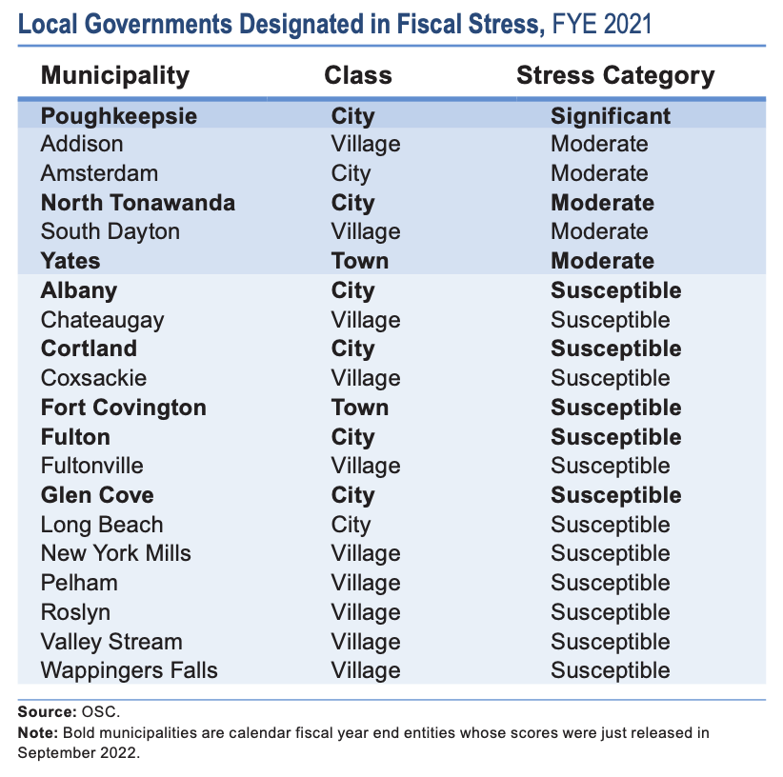
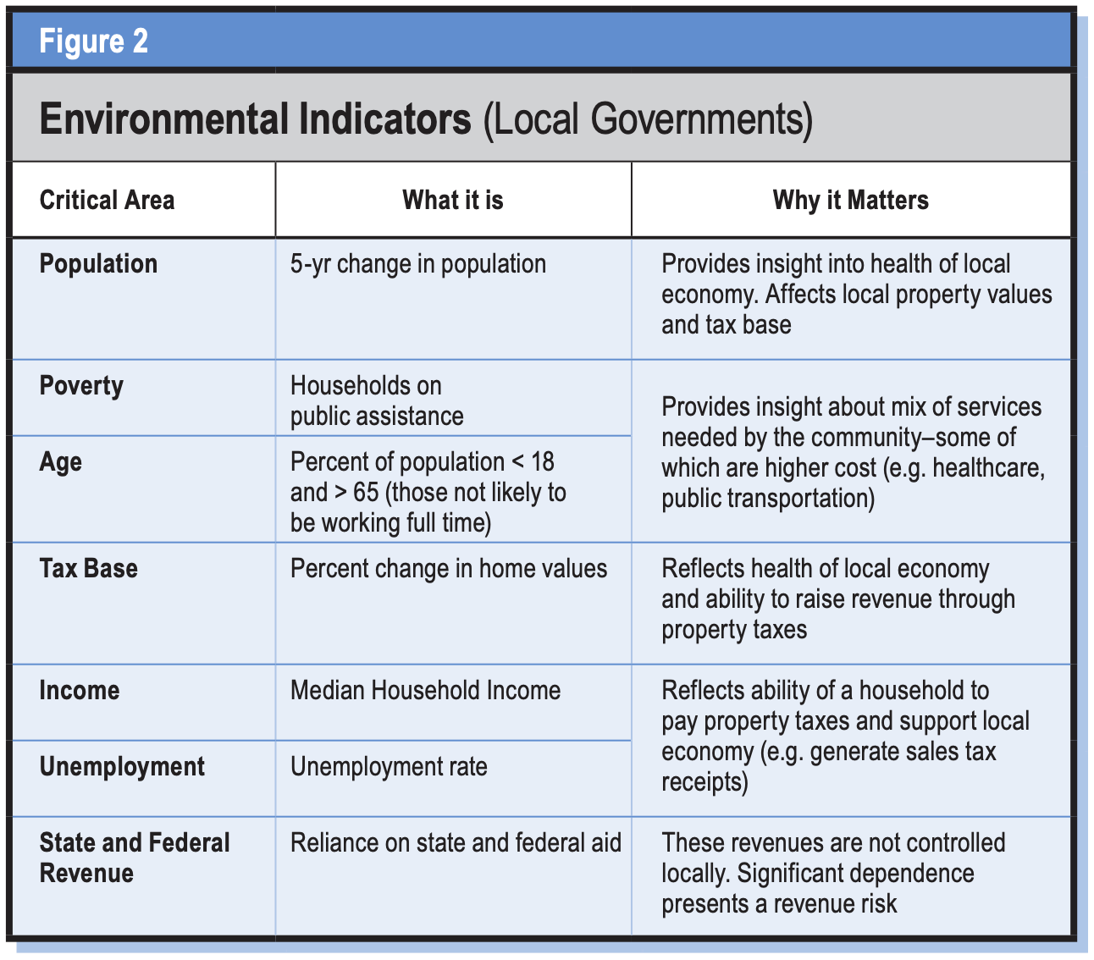
Fiscal Stress Monitoring System
https://www.osc.state.ny.us/local-government/fiscal-monitoring
https://www.osc.state.ny.us/files/local-government/fiscal-monitoring/pdf/system-manual.pdf

Slide 32
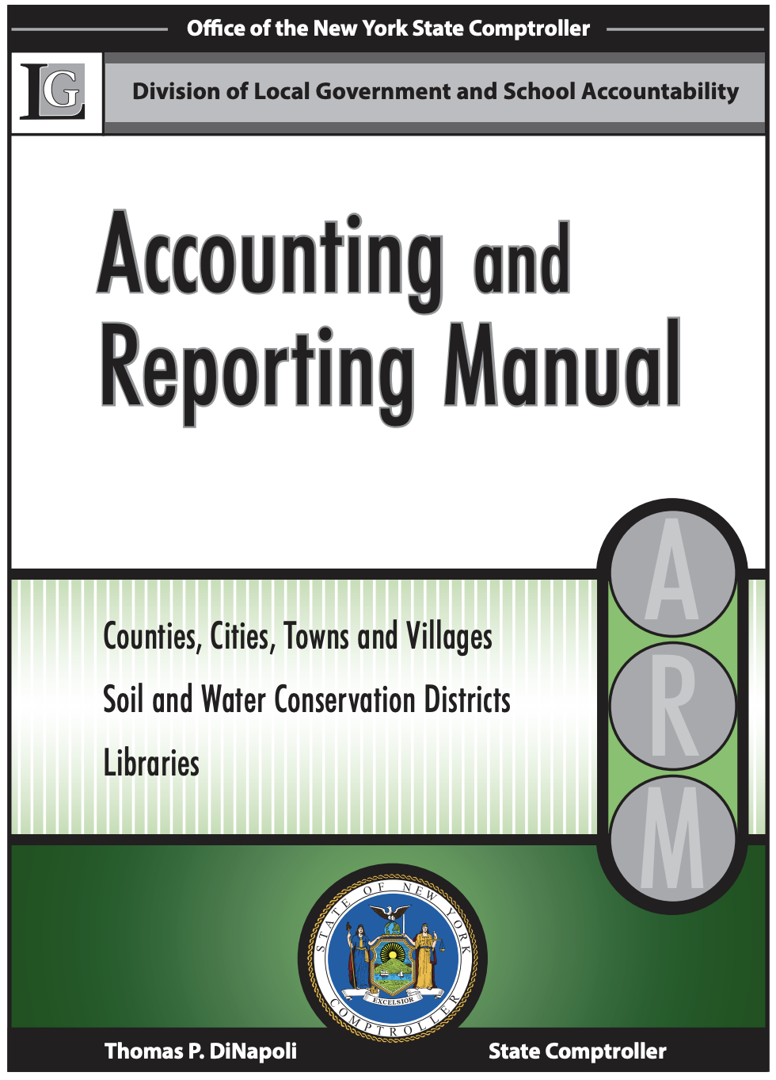
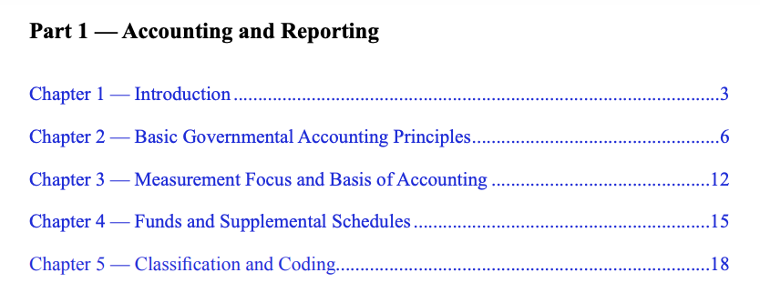
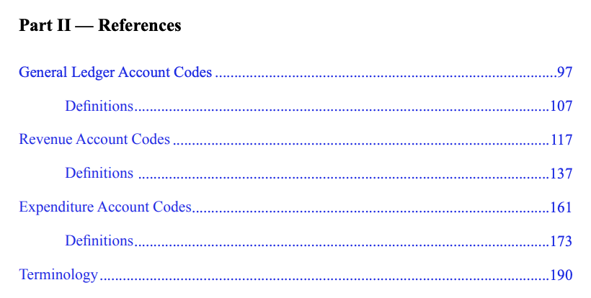
https://www.osc.state.ny.us/files/local-government/publications/pdf/arm.pdf
*️⃣
*️⃣
*️⃣
*️⃣
= especially useful for data analysis

Slide 33
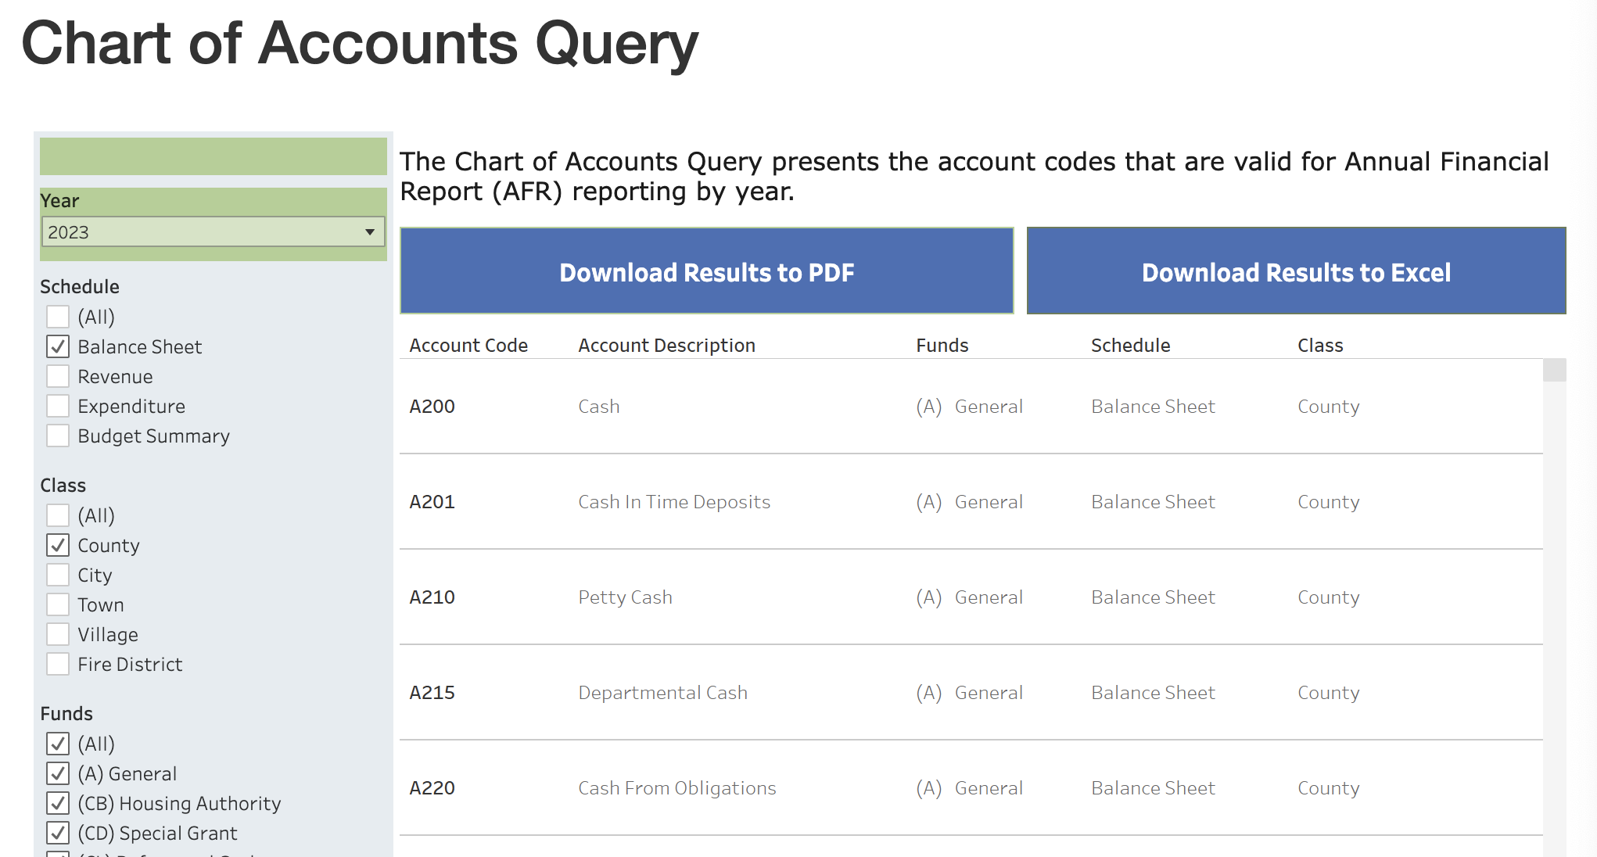
https://www.osc.state.ny.us/local-government/required-reporting/chart-accounts-query

Slide 34
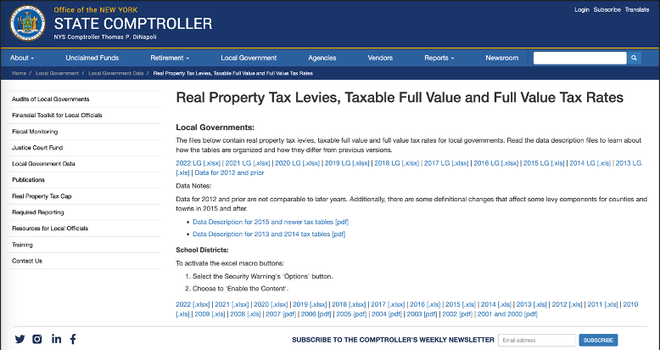
https://www.osc.state.ny.us/local-government/data/real-property-tax-levies-taxable-full-value-and-full-value-tax-rates

